Slide 1


TECHNOLOGY
Consensus 2023 Hackathon
TECHNOLOGY
BY: AdMeta
2023/5/27

Slide 2
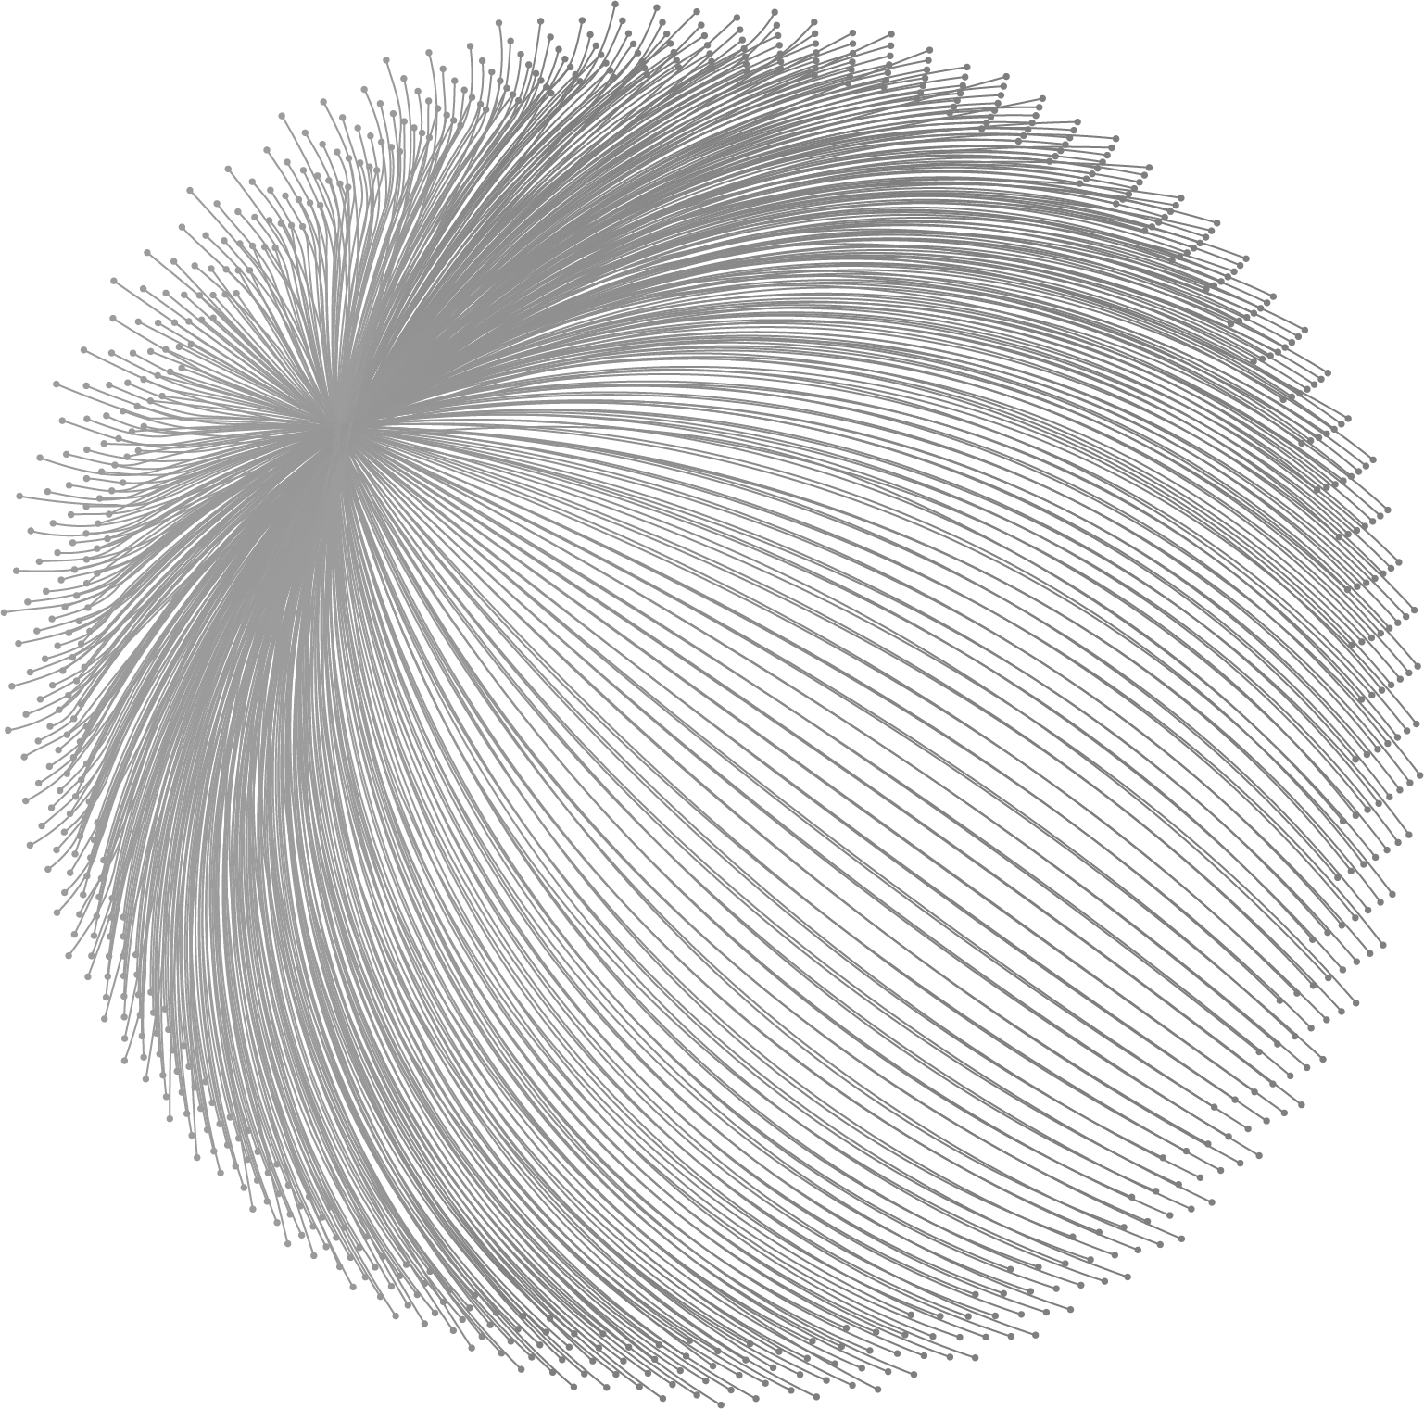
CONTENT
Background
01
Demend
02
Architecture
03
Roadmap
04

Slide 3

PART ONE
01
Background
PART ONE

Slide 4
WORK OVERVIEW
Background
Overview
AdMeta is a Web3 advertising protocol that is entirely designed and customized for Web3. It is deployed on the XDC chain and uses Civic Pass as a means of identifying citizens.
Based on users' on-chain and off-chain behaviors, AdMeta helps Web3 projects acquire users and promote their products in a decentralized way.
Unlike Web2 advertising platforms, in AdMeta users own, control and profit from their own data. The data used for ad matching is fully authorized by the user and is processed in a privacy-protected manner.
AdMeta also enables Web3 content creators, and Metaverse landholders to monetize their content and land in a simple and decentralized way.
AdMeta

Slide 5
02
PART TWO
Demand
PART TWO

Slide 6


WORK PROGRESS
Demand
Web3 start-ups/companies
Web3 start-ups face challenges in promoting their products and services, with existing marketing strategies being time-consuming, inflexible, and inefficient. A Web3 native advertising platform can address these issues and leverage Civic for identity verification.
WORK PROGRESS

Slide 7
WORK PROGRESS
Demand
Web3 users
Web3 users are increasingly concerned about privacy issues, and AdMeta's blockchain-based solution guarantees no data misuse and leakage while providing a fee model where advertising fees are paid directly to users, managed in a decentralized way.
WORK PROGRESS

Slide 8
PART THREE
03
Architecture
PART THREE

Slide 9
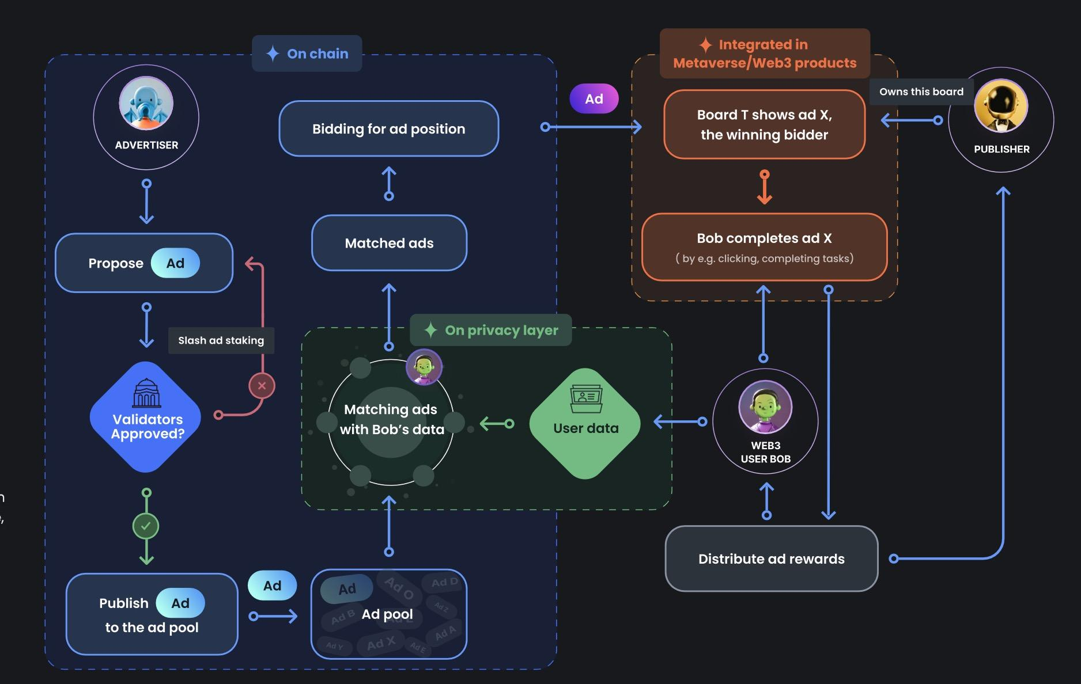
PROBLEMS ANALYSIS
Workflow
PROBLEMS ANALYSIS

Slide 10
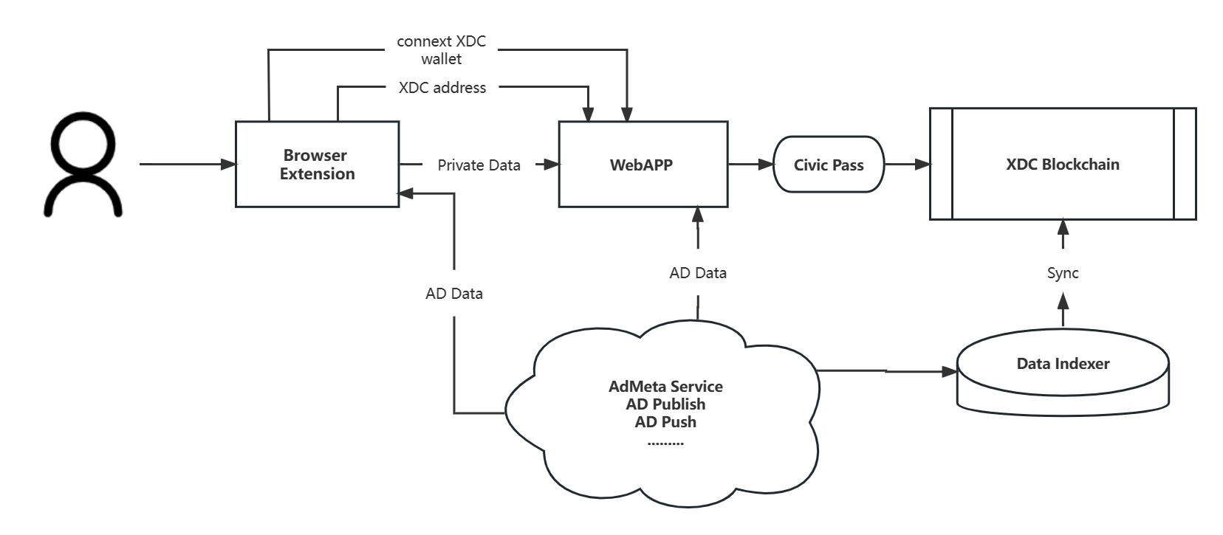
PROBLEMS ANALYSIS
Workflow
PROBLEMS ANALYSIS

Slide 11
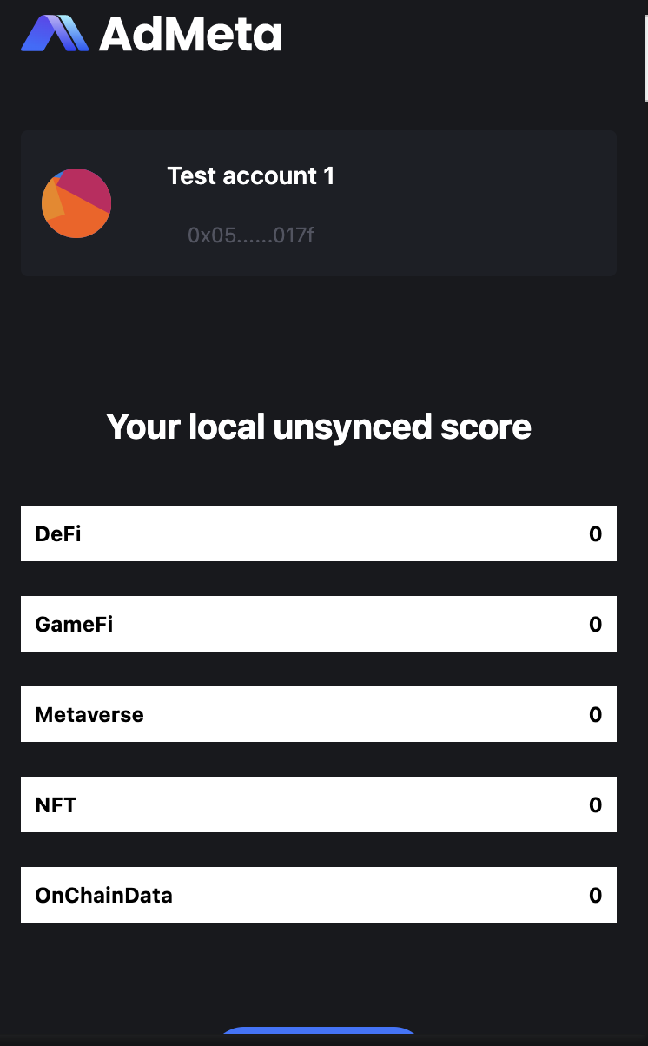
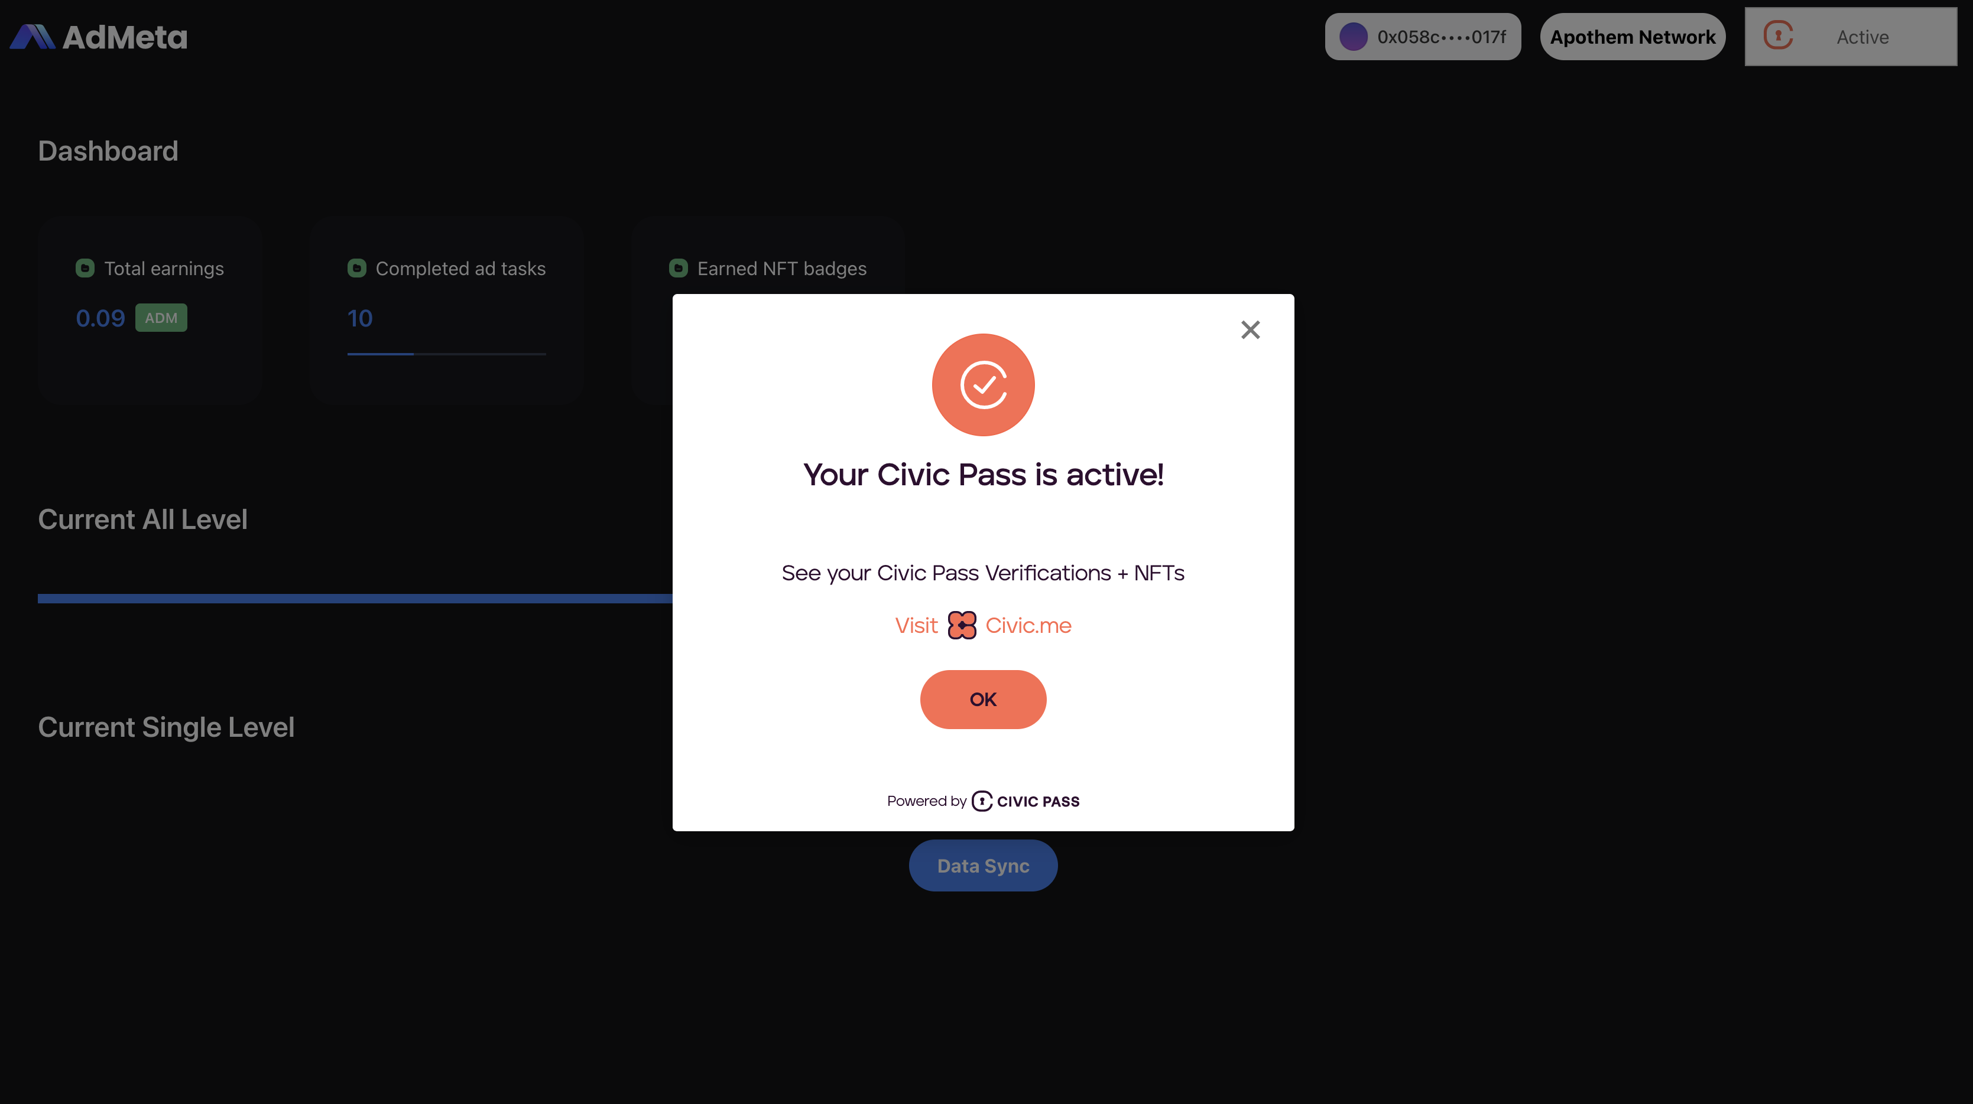
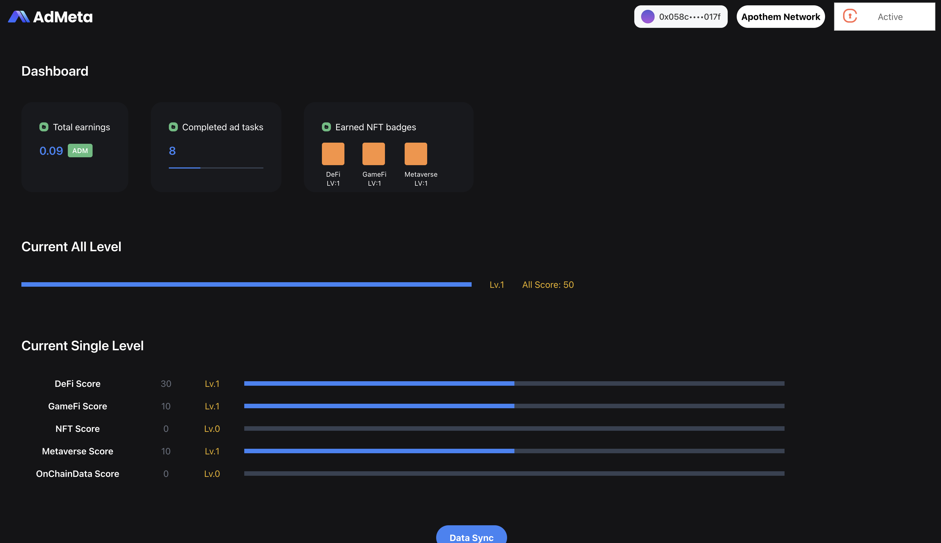
PROBLEMS ANALYSIS
Product
Dapp
Civic Pass
Extension
PROBLEMS ANALYSIS

Slide 12
PART FOUR
PART FOUR
04
Roadmap

Slide 13

WORK PROGRESS
Milestone
05
04
M5- AdMeta DAO
03
M4- Accessibility for Non Web Advertisers
02
M3- Integratable Ad Modules
01
M2- Privacy Layer Integration
M1- Surf-to-Earn

Slide 14
PART FOUR
PART FOUR
05
Video

Slide 15
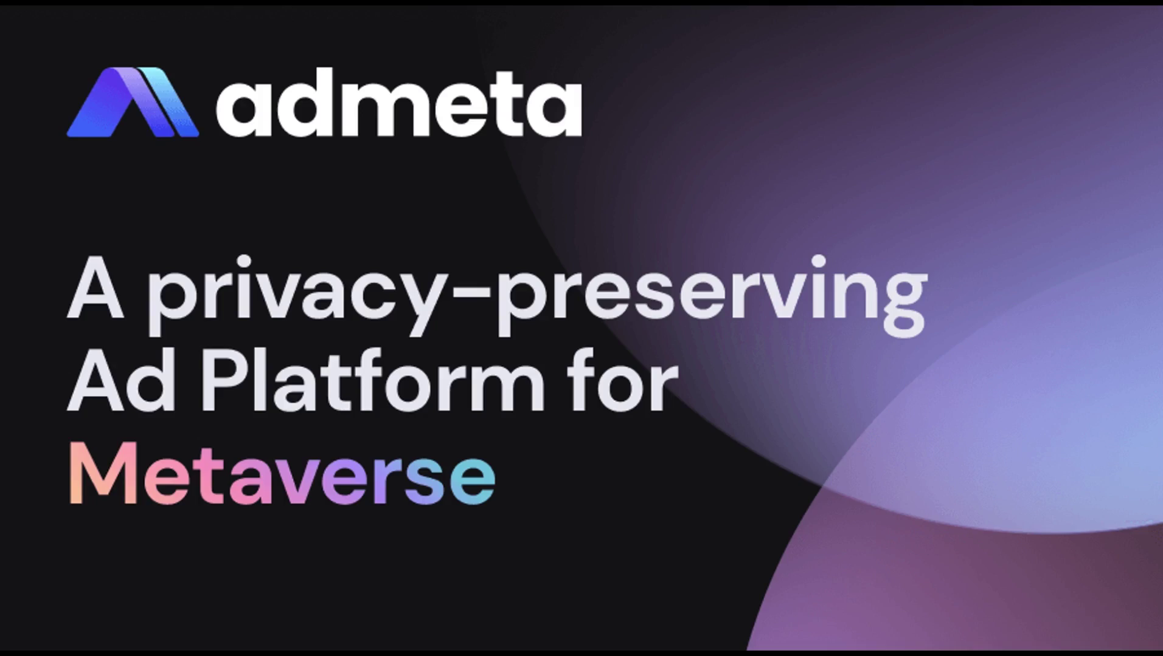
PART FOUR
PART FOUR

Slide 16
PART FOUR
PART FOUR
06
Contact Us

Slide 17
PART FOUR
PART FOUR
Website: https://admeta.network
GitHub: https://github.com/AdMetaNetwork/hackerearth-admeta
Twitter: https://twitter.com/AdMetaNetwork

